Slide 1

Factors Influencing the Sales of Walmart
BY: AKSHAY, JASPREET, KAVACH & OMKUMAR.

Slide 2
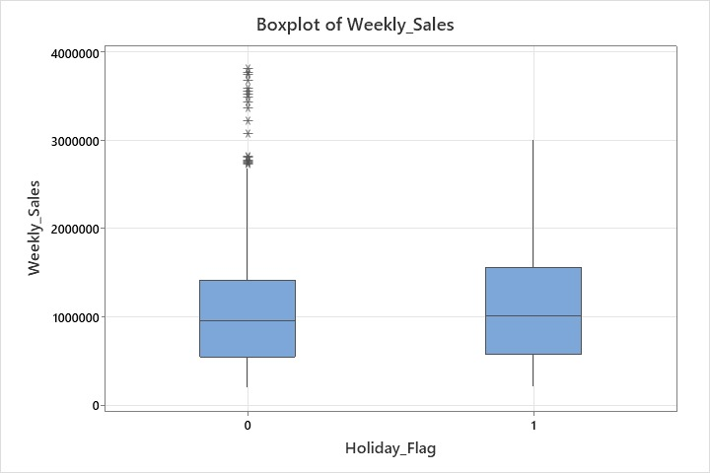
What is the Impact of Holidays on Sales in Walmart?
Average Sales when there is a holiday = $ 1 122,888
Average Sales when it is not a holiday = $ 1, 041, 256
Holiday period shows a clear increase in sales compared to non-holiday times.

Slide 3
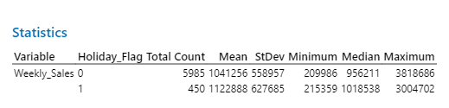
The table summarizes key statistical metrics for a variable named, Weekly sales across two categories of a Holiday:

Slide 4
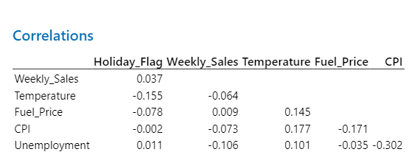
What is the Correlation Between External Factors and Sales of Walmart ?

Slide 5

What factors contribute to the variation in sales among different stores?
Several factors can contribute to the variation in sales among different stores, especially in a large retail chain like Walmart. These factors typically fall into a few broad categories:
Population Density: Areas with higher populations likely see more foot traffic and sales.
Income Levels: Wealthier areas may have higher sales volumes due to greater purchasing power.
Local Economic Conditions: Stores in regions experiencing economic difficulties may see reduced sales.

Slide 6
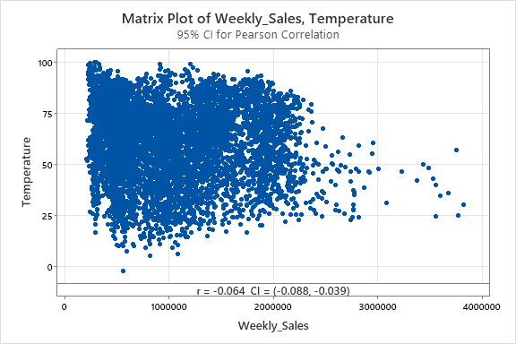
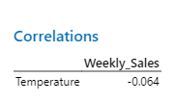
Is there a significant correlation between weekly sales and temperature?
A weak negative correlation.
Correlation Between Weekly Sales and Temperature, Weather-related shopping habits: In colder weather, people may be less likely to go out for shopping unless necessary, potentially leading to lower foot traffic. Conversely, extreme heat may deter people from visiting stores, preferring online shopping instead.

Slide 7
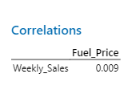
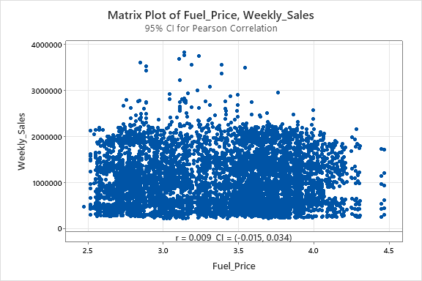
How does fuel price correlate with weekly sales?
Indirect Effects: While the data suggests no strong correlation, higher fuel prices could impact disposable income. Consumers might cut down on discretionary spending, or shop more at Walmart because it's perceived as offering low prices. Geographical Variance: In rural areas where customers rely more on cars, fuel price fluctuations might have a greater impact on their shopping behaviour compared to urban areas.
ThePhoto by PhotoAuthor is licensed under CCYYSA.

Slide 8

LIMITATIONS:
1. The Dataset
Time Scale: If the dataset contains only a brief, short amount of time, then long-run and seasonal variations may not be picked up.
Geographical: Data from an incomplete number of Walmart stores or regions cannot indicate nationwide or global sales patterns.
2. Omission of Online Sales Data
If it were only the case of in-store sales, the analysis may very well steer away from the ever-growing importance of e-commerce. Walmart's online platform has grown impressively, particularly during the pandemic, and the ignorance of such data may be a misrepresentation in the overall sales perspective.
3. External Factors Not Well Explored
Although temperature and fuel prices are examples of external variables examined, other significant variables that could help explain sales performance, such as inflation, interest rates, or global supply chain issues may also influence sales and were not included in the analysis
Competitor Behavior: It might not depict how the promotion, pricing, opening, and closing of stores by competitors influence Walmart's sales.
4. Bad Correlations
The study speaks to weak correlations, such as temperature and sales. These kinds of findings are precarious to construct strong conclusions on, since they are due to chance or driven by other unmeasured factors.

Slide 9
5. Holiday Impact Not Generalizable
Although holidays elevate sales, the study does not make any discrimination on the type of holiday; for instance, between Christmas and Memorial Day. Different holidays have different kinds of influences, depending on their cultural relevance, promotional efforts, and consumer anticipation.
6. Time Variations
Sales can also be affected by temporary factors such as weather storms and disruptions peculiar to a particular region. These may not be reflected in the survey as they can be transient or regional and may distort the trend.
7. Absence of Causality
This could show a correlation instead of the causation of the study. For instance, it might be that sales are higher over holidays; however, this does not mean that holidays alone are the drivers of higher sales. It can also be due to more marketing, better consumer confidence, or specific promotions.
8. Pandemic Impact
If this information does not include the period of the COVID-19 pandemic, such data will not capture key changes in customer behavior in terms of increased purchases made online, changing preferences for certain products-examples include demand for essential products supply chain disruptions, or stock-level changes.

Slide 10

THANK YOU..

